Slide 1

Metadata Agents and Semantic Mediation
Mikhaila Burgess
Cardiff University
Notes:
Good afternoon. My name is Mikhaila Burgess and I’m a research associate in the BDW project
My responsibility has been to look into the metadata requirements for the BDW project and the development of an ontology to store required semantic information.

Slide 2
Overview
BiodiversityWorld Metadata Repository
BDW Ontology
Chosen ontology tools
Ontology structure
Metadata Agents
Metadata in the BDW environment
Further developments
Notes:
*******EEEKKK!!! More work needed on notes for this slide*********
MDR – for storing metadata required by BDW
“data about data”, primarily info about the resources that are available in the BDW environment.
Ontology
What we mean buy the term
Why we are using one
Describe the current version
Ontology structure
what sort of information it holds
what it looks like
current relationships between elements
Metadata agents – what they are and what they do
Metadata in BDW – how the pieces fit together within BDW

Slide 3
Metadata Repository (MDR)
To store BDWorld metadata - “data about data”
Composed of:
  Resource Registry
  BDWorld Ontology
  Ontology tools – inc access, update, query
Access methods:
  Web front-end (eg Resource Registry)
  Ontology GUI
  Metadata Agents
Notes:
The Metadata Repository is to be used to store the metadata required by the BDW environment, primarily metadata about the resources that are available for use, such as details about their functionality and how they can be used.
Resource registry currently store some information about available resources. However, to be able to store semantic information about our metadata we’re also developing an ontology, along with a set of tools that can use it.
The current methods for accessing the different parts of the MDR include the web front end for the resource registry, which was introduced earlier, using which information can be entered about resources currently available for use.
Ontology tools are available to enable viewing and editing of ontologies via a user interface, rather than editing the ontology directly, in whichever language it’s being stored. We’re currently using an off-the-shelf ontology GUI for this purpose, which is customisable to our specific needs.
The metadata agents will be a software interface to the MDR, primarily to provide semantic information to the workflow manager. These have not yet been incorporated into BDW.

Slide 4
Metadata Repository
To allow resources to publish their metadata
  Describe the type of resource
  Supported operations
  Supported data types
  Access methods
Supply information to workflow manager:
  Locating suitable resources & operations
  Ensure operation compatibility
Manage workflow provenance information
Notes:
One aim of the MDR is to allow resource owners to publish information about their resource, so that it can be used in the BDW system.
This info includes descriptions of the resource, details of the operations they provide (what operations are available, what do they do, how are they accessed) and what datatypes they both accept as input and that they produce as outputs.
Example of tasks MDR can assist with (not limited to this):
Assist the workflow manager in locating appropriate resources and operations from those currently available.
Advanced data type checking to ensure that operations are compatible, both syntactically and semantically.
Workflow provenance – not yet doing this – future work
Storing of info about previous workflows
What was run,
What resources and parameters were used
Who ran the workflow, and when
Information about the results that were obtained

Slide 5
Ontology: a definition
“An ontology defines a common vocabulary for researchers who need to share information on a domain. It includes machine-interpretable definitions of basic concepts in the domain and relations among them.”
Some reasons:
  Extracting domain knowledge (explicit, analysis)
  Reuse of domain knowledge
  Sharing common understanding of the structure of information
Notes:
Makes domain assumptions explicit
One common goal of ontologies - Sharing between people, computers, software agents

Slide 6
Ontology: What is it?
Ontology is a formal explicit description of:
  concepts in a domain of discourse (classes, concepts)
  properties of each concept describing various features and attributes of the concept (slots, roles, properties)
  restrictions on slots (facets, role restrictions)
Knowledge base - an ontology, with a set of individual instances of classes/concepts
Entity/Object
Attribute
Value
Notes:
For those familiar with OAV / EAV triple representation format
Ontology plus instances constitute a knowledge base

Slide 7
Why do we want an ontology?
Storing and sharing of semantic information
Answering questions:
  Which resources can provide information on legumes?
  Find operations that are similar to a given operation.
  Which operations accept map coordinates?
  Given a specific operation, which other operations will accept its output?
Notes:
Some example questions that we could use the ontology to answer …
Search using thesaurus – look for resources with ‘legume’ in the name and description, and also those containing terms that have been stated as being similar, eg beans.
When creating a workflow – can show other similar options. Useful if a currently selected operation becomes unavailable (eg taken offline)
Advanced Type checking – making sure the resource knows what to do with the data you’re sending it. Not adequate to say that operation x outputs a string and operation accepts a string, when the first is a species name and the second in a geographical region
To help when creating workflows – if you take an output from one component the system could help by identifying those components currently available that can accept the specified output.

Slide 8


Protégé & Jena
Protégé
  Open source ontology editor
  Knowledge base framework
  Number of plug-ins available
  Customisable
Jena
  Java framework for building Semantic Web apps
  Programmatic environment – RDF, RDFS, OWL
  Rule-based inference engine
Notes:
Many tools available: Ontolingua (standford), ontoedit (ontoprise, germany), OILed (manchester)
Languages: RDF/XML, DAML+OIL, OWL
-------------------
Protégé is a tool which allows users to construct domain ontologies, customize data entry forms, and enter data. It is also a platform which can easily be extended to include graphical components such as graphs and tables, media such as sound, images, and video, and various storage formats such as OWL, RDF, XML, and HTML.
The Protégé Application Programming Interface (API) makes it possible to for other applications to use, access, and display knowledge bases created with Protégé.
-------------------
Jena is a Java framework for building Semantic Web applications. It provides a programmatic environment for RDF, RDFS and OWL, including a rule-based inference engine.
Jena is open source and grown out of work with the HP Labs Semantic Web Programme.
The Jena Framework includes:
A RDF API
Reading and writing RDF in RDF/XML, N3 and N-Triples
An OWL API
In-memory and persistent storage
RDQL – a query language for RDF

Slide 9
Ontology Contents
Resources
  Datatype: Name, Description, Type, Owner, …
  Object: Operation(s), Endpoint(s), …
Operations
  Datatype: Name, Description, Usage, Num ports, …
  Object: Ports, Resource(s), Author/Owner, Similar Operation(s), …
Ports
  Datatype: Type, Optional, Default
  Object: Data type, Operation(s)
Notes:
Resource:
Type – Analytic or Data
Port:
Type – Input/output
Optional – yes/no
Default – yes/no
Other – more details later

Slide 10
Ontology Contents
Data Types
  Java, XML, etc
  Link to operations
Acronyms: expansion, definition(s)
Keywords
  Definition(s)
  Synonyms & Antonyms
  Similar terms
Two levels of metadata …

Slide 11
Levels of Metadata
Metadata - “data about data”
Meta-metadata – data about metadata
BDW metadata:
  Resource Name
  Description
MDR data:
  “AVH Database”
  “Australia's Virtual Herbarium”
Meta-metadata
Ontology metadata
Metadata
Instance data

Slide 12
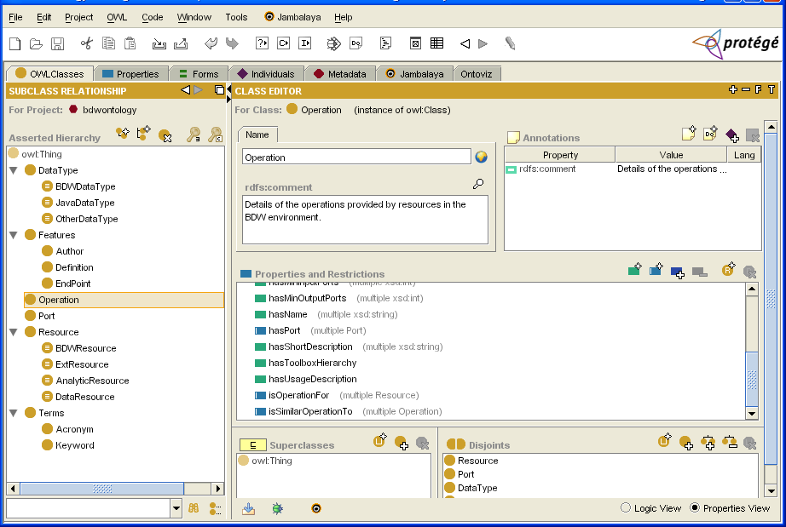
BDW Ontology in Protégé
Datatype property
Object property
Notes:
Protégé’s GUI – creation, updating, browsing ontology
Datatype property – relationship between object and a data element - eg storing operation name
Object property – relationship between two or more objects – eg isOperationFor

Slide 13
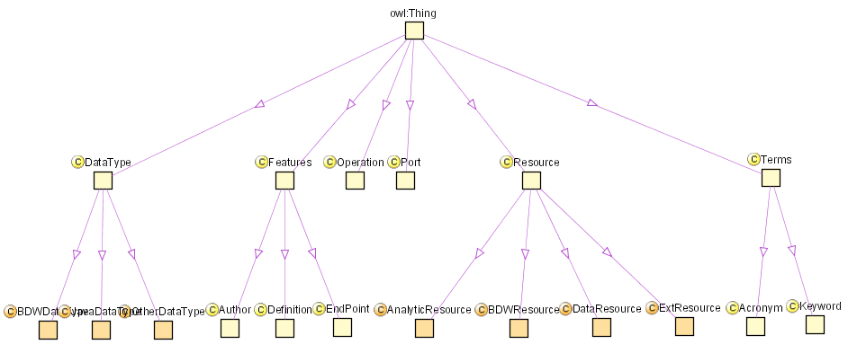
Ontology Viewing
Notes:
Jambalaya tool – a plugin to Protégé
Gives a graphical overview of what elements are included in the ontology.
It also allows editing of the ontology

Slide 14
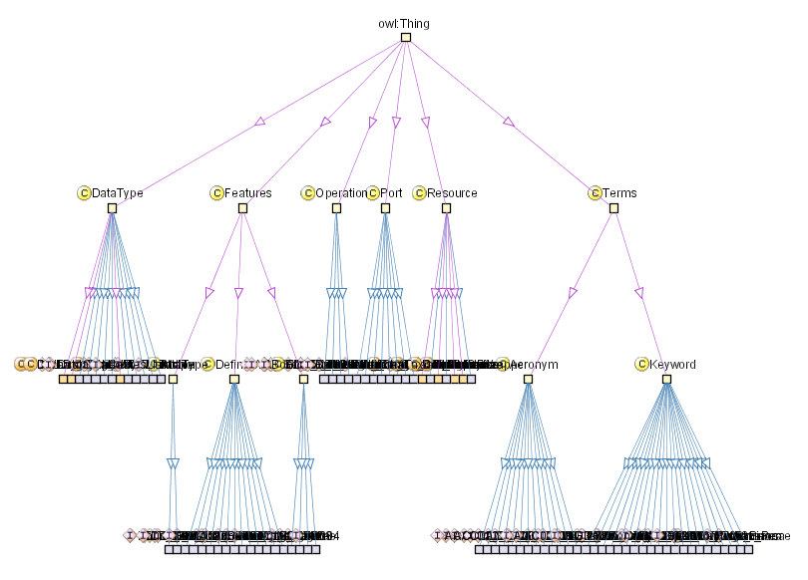
Ontology Viewing
Notes:
Jambalaya tool – also allows you to view all instances
Currently only a small number of instances recorded in ontology (as still in development stage)
- can zoom in on individual instances and edit occurrences via this graph
More objects and instances – unreadable, but still navigable / traversable

Slide 15
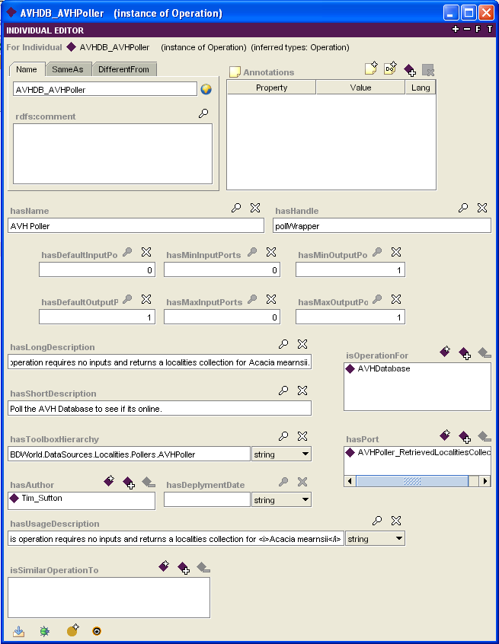
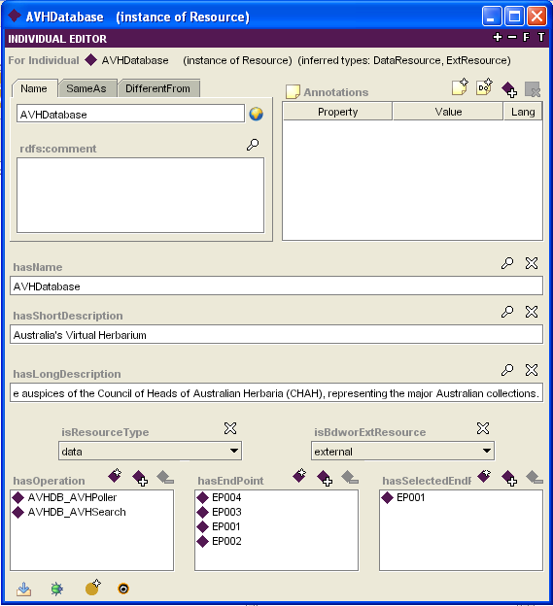
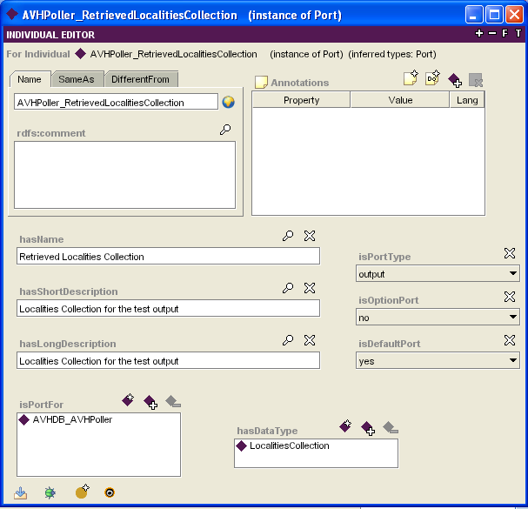
Instances and Relationships
Notes:
Example of information available, and how we can navigate through the ontology.
Look at an instance of the resource class – ‘AVH Database’

Slide 16
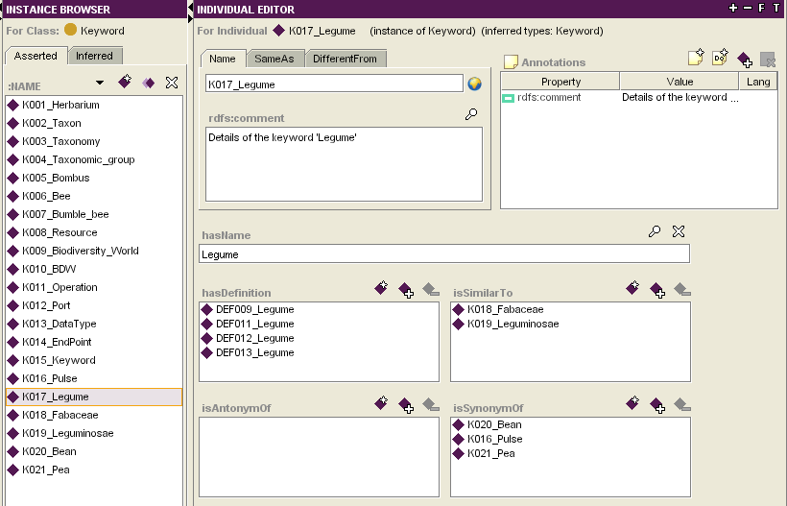
Terms/Keywords
Definitions
Related terms
Opposite
Interchangeable
Notes:
Start of the BDW thesaurus
Small number of terms currently in system for demonstration purposes – as ontology still under development
Number of terms will increase once ontology is fully tested
Red oval Names – unique id’s
On left can see they are all readable – this is for testing and demonstration purposes
Values could be anything – automatically generated unique alphanumeric ID. This will be case in live version of ontology.

Slide 17
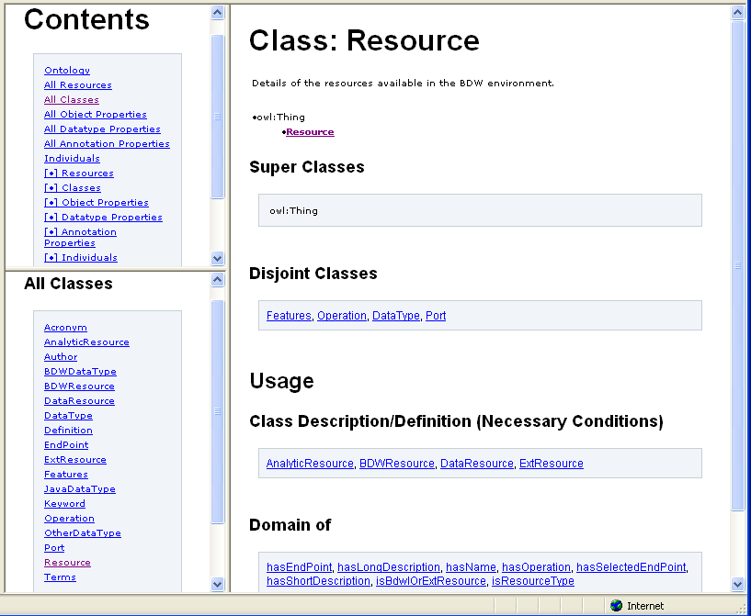
The Ontology Online
Notes:
The current version of the BDW ontology is available to view online, both in in a browsabe format and in OWL. If anyone would like to take a look at this I can provide the URL later.
URLs:
http://users.cs.cf.ac.uk/M.Burgess/bdworld/ontology_web/
http://users.cs.cf.ac.uk/M.Burgess/bdworld/ontology_owl/

Slide 18
Metadata Agents
An interface to the MDR
Multiple instances for a single MDR
Primary role of Metadata agents:
  Resource Locating
  Resource Matching
  Resource Discovery
Provide metadata and semantic information to workflow manager

Slide 19
Initial Operation Set
Vocabulary queries
  Retrieve all resource names
  Retrieve all operation names
Selection queries
  Retrieve all resources meeting specific criteria
  Retrieve all operations with specific output
Matching queries
  Which operations accept data type x?
  Which operations output specific data type?

Slide 20

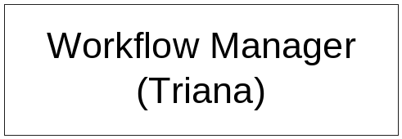
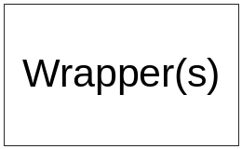
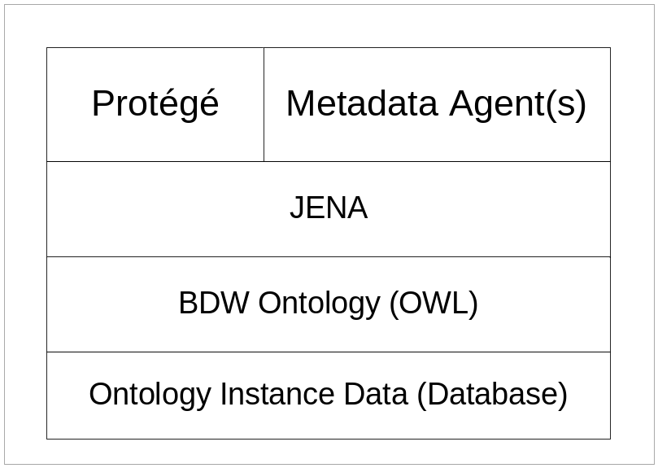
How the MDR will fit into BDW
Ontology GUI
Multiple wrappers
& resources
Inference
engine
Multiple instances
Currently: OWL
Future: Database

Slide 21

Further Development
  More work on inference engine (Jena)
  Linking Metadata Agents to Jena
  Refining/Improving ontology
  Testing of resource registration methods
  Storage of more metadata
  Putting it all together – Semantic Mediation
Notes:
More work on inference engine (Jena)
In experimental stage at moment
Linking Metadata Agents to Jena
still in early stage of development
Metadata Agent code exists – just not yet linked to Jena
Refining/Improving ontology
Ontology development is an iterative process
When used we’ll be able to see what needs improving, and what else needs to be recorded
Testing of resource registration methods
Using Resource Registry – push or pull of info between RR and Ontology
Registering directly with Ontology
Storage of more metadata
eg, Workflow provenance info
Putting together
improving type checking in workflow manager
Assisting user in finding appropriate resources and operations when creating workflows

